Slide 1
Marketing Lecture # 10 Muhammad asad Instructor department of computer science

Slide 2
Key Learning Point :-
- Discussion about the market targeting

Slide 3
STEP#2: MARKET TARGETING STRATEGIES
After evaluating different segments, the company must decide which and how many segments it will target.
A target market consists of a set of buyers --- Who share common needs or characteristics that a company decides to serve.
After having evaluated the identified market segments --- We select the segment / segments most profitable ones for the company.

Slide 4
FOUR TYPES OF MARKET TARGETING
STRATEGIES
UNDIFFERENTIATED
DIFFERENTIATED
CONCENTRATED
MICROMARKETING

Slide 5
UNDIFFERENTIATED MARKET TARGETING
A business might decide to ignore market segment differences --- and --- Target the whole market with one offer.
Such a strategy focuses on --- What is common in the needs of consumers rather than on what is different.
The company designs a product and a marketing campaign that will appeal to the largest number of buyers.

Slide 6
In simple words, This strategy considers buyers as homogeneous group --- Undifferentiated marketing is also known as mass marketing --- Companies do not produce different products for different market segments --- Relies on mass distribution and mass advertising.
A advantage of undifferentiated marketing is that it’s cost-effective --- It has a narrow product line which leads to low advertising cost --- Lack of segment reduces the costs of marketing research.

Slide 7
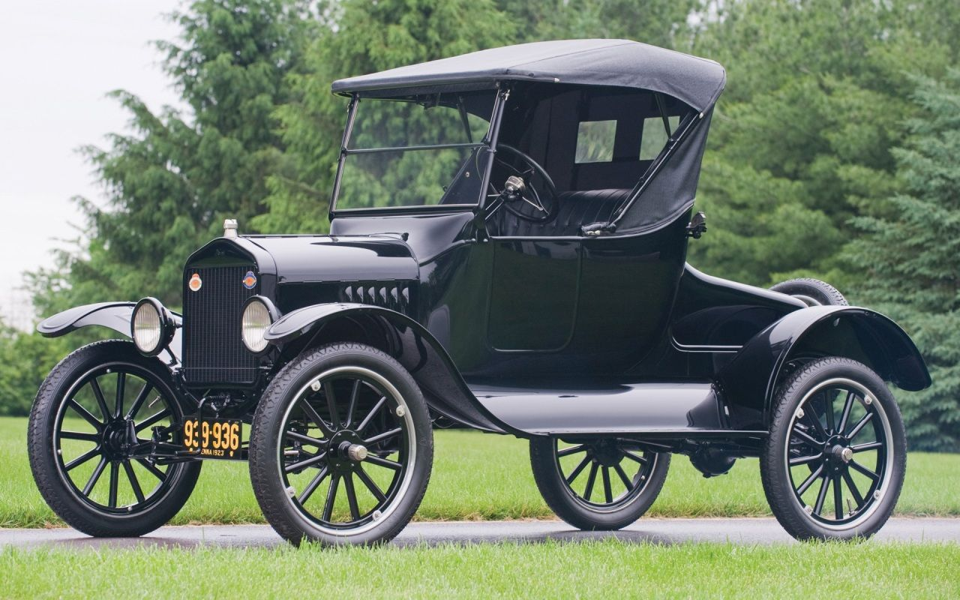

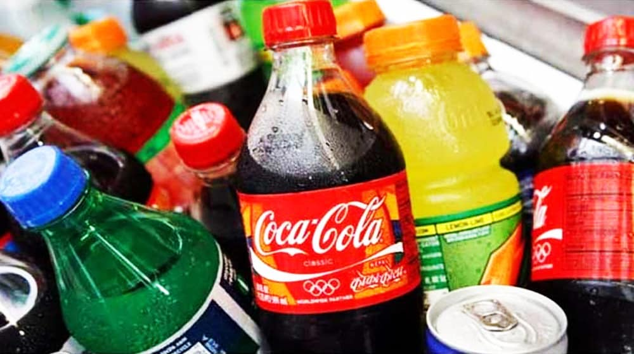
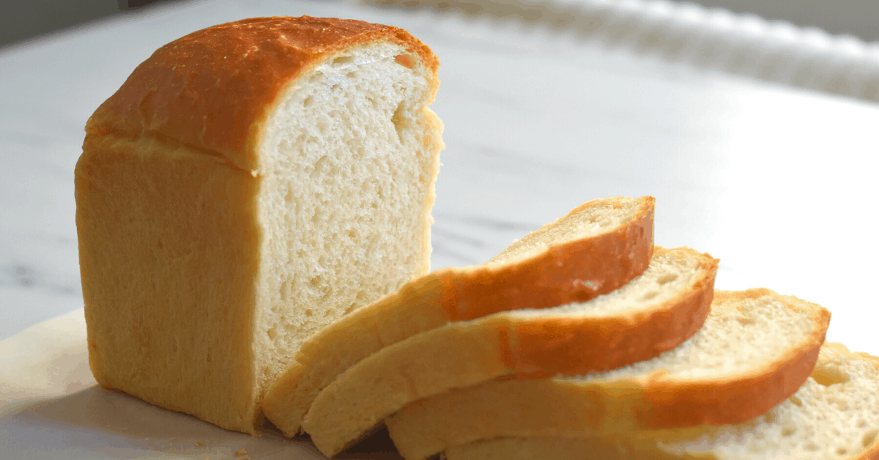
FOR EXAMPLE
Henry Ford adopted undifferentiated marketing strategy
for T Ford Model --- This model was available
in only black color in 1930s.
For certain types of widely consumed items --- Such as gasoline, soft drinks, white bread and etc. --- The undifferentiated market approach makes the most sense.

Slide 8
DIFFERENTIATED MARKET TARGETING
The business decides to target several market segments and designs separate offers for each segment --- Target two or more clearly defined customer segments --- With a particular product and a unique marketing strategy tailored for every segment.
A Differentiated market targeting approach is likely to create more sales than does undifferentiated marketing --- But due to separate marketing mix --- The promotion cost also increases --- A business is required to balance revenue generated from multiple segments to the costs associated with these segments.

Slide 9
A advantage of differentiated marketing is that --- In every market, customer needs and preferences are varying --- Businesses can target those markets --- Where competitors do not have suitable offerings to satisfy consumers.
A disadvantage of differentiated marketing is that --- Customizing products and marketing it --- To each segment is an expensive activity --- Creating different versions and variation of a product means more research & development time and cost --- Than creating a single product --- Moreover, to present separate messages, companies need to market and sell the product to appropriate target segment heavily.

Slide 10
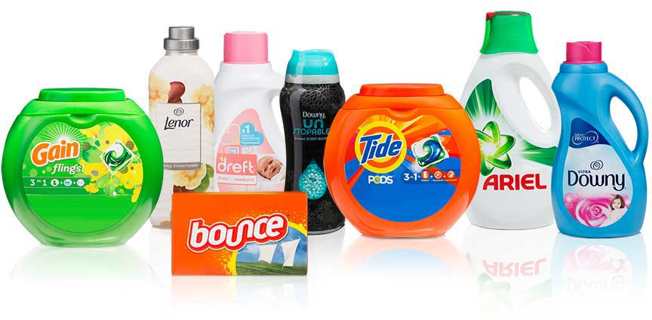
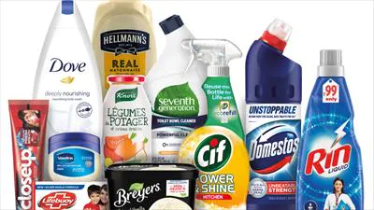
FOR EXAMPLE
A restaurant can target both college students and families. The restaurant can offer in-expensive food and drink menus for college students. On the other hand, it can also appeal to a kid-friendly environment and meal options for families.
The segmentation of Unilever and P&G generates more sales by achieving higher market share through various detergent brands which they could not with just one brand.

Slide 11
CONCENTRATED MARKET TARGETING
A type of marketing strategy where the business marketing efforts are focused to a well-defined market segment --- Focused and target specific market segments --- A strategy in which a business target a large share of one or a few segments.
For a business to succeed in concentrated marketing, it must have a better marketing program for its target market as compared to its competitors.

Slide 12
This marketing approach is effective for those businesses --- Who have limited resources (cannot expand after a certain level), skilled and specialized in manufacturing products.
High developed and specialized market plan is required to implement --- Because, totally dependent on a single / few market segment.

Slide 13
FOR EXAMPLE
Specialized home furniture provider, well-designed housewares shops, Pizza Hut and etc.
Facebook, that’s not adopt concentrated marketing strategy! In its current form.
But Facebook launched as a highly-targeted unique service --- An online site for Harvard students to make connections and share photos.
After success on Harvard’s campus, Facebook expanded to colleges and universities across the U.S. --- and --- Then it became the universal social media platform we know today, available to everyone around the world.

Slide 14
Facebook is a prime example of --- How improving your product or service --- With a small group of users / customers --- Can prepare it to launch to a wider audience (if that’s appropriate or in your plans).

Slide 15
MICROMARKETING MARKET TARGETING
Differentiated and concentrated marketers tailor their offers and marketing programs --- To meet the needs of various market segments --- However, they do not customize their offers to each individual customer.
A type of marketing strategy where the business marketing efforts are focused --- Tailoring products and marketing programs to the needs and wants of specific individuals and local customer segments --- It includes local marketing and individual marketing.

Slide 16
Local marketing involves tailoring products and marketing to the needs and wants of local customer segments (cities, neighborhoods, and even specific stores) --- Is a strategy that targets potential customers within a specific radius (typically 50 miles) --- Of the physical location of a business.
Local marketing is especially important for small and medium-size businesses --- That rely on people visiting their physical location to purchase goods or access a service --- Such as, shops, dentists, physiotherapists, bars, restaurants, car dealerships and etc.

Slide 17
EXAMPLE OF LOCAL MARKETING
LOCALIZED MCDONALDS MENUS
Anyone who thinks McDonald's only sells BigMacs, Chicken Nuggets, Cheeseburgers, and McFlurry's is wrong.
McDonald's has been adapting its range --- To the countries in which it operates for years --- To name a few MENU
In Spain, they have the "Patatas Deluxe“
In India the "Dosa Masala Burger“
In the Netherlands the "McKroket"
In South Africa, they have replaced the standard BBQ sauce for the McBraai sauce

Slide 18
Individual marketing involves Tailoring products and marketing programs to the needs and preferences of individual customers --- Is a strategy, the demand can be directly communicated to the suppliers or manufacturers --- and --- They can be provided with customized products as per their demand.
The more data you get from your consumers --- The more tailored your marketing can be.
Don’t just make it personalized, make it shareable.

Slide 19
EXAMPLE OF INDIVIDUAL MARKETING
STARBUCKS
Starbucks successfully keeps customers engaged with its gamified mobile app.
Mixing the brand’s rewards system with the ability to customize and order drinks via the app --- It makes use of information such as purchase history and location --- To get as personal as possible.
The introduction of the rewards system saw Starbuck’s revenue rising to $2.56 billion, while the app has generated around 6 million sales per month (around 22% of all U.S. sales).

Slide 20
EXAMPLE OF INDIVIDUAL MARKETING
COCA COLA
The famous ‘Share a Coke’ campaign, first launched in Australia in 2012 --- Still retains its title as one of the most original examples of personalized marketing to date.
The idea was to spread advocacy and love for the brand --- By replacing the soft drinks logo with consumer names --- Encouraging people to share with friends and spread the brand’s message using the hashtag #shareacoke.

Slide 21
In the wake of the original campaign, Coca Cola Co. saw a rise in sales for the first time in over a decade.
A spokesperson from Coca-Cola said…
“This campaign taught us that personalization can only be highly engaging and effective --- If it can be shared with a wide audience.”

Slide 22
GEOGRAPHIC SEGMENTATION
Urban --- 40%
Rural --- 60%
Sahiwal Region --- 80%
Out-side Region --- 20%
Summer Time of Year --- 75%
Winter Time of Year --- 25%
PSYCHOGRAPHIC SEGMENTATION
Socially Acceptable
BEHAVIORAL SEGMENTATION
Quality Preference --- 80%
Quantity Preference --- 20%
Sport Festival Participation --- 30%
Annual Dinner Participation --- 95%
Presentations Participation --- 100%
DEMOGRAPHIC SEGMENTATION
Male --- 70%
Female --- 30%
Muslim --- 99%
18+ Age --- 100%
Under-graduate --- 100%

Slide 23
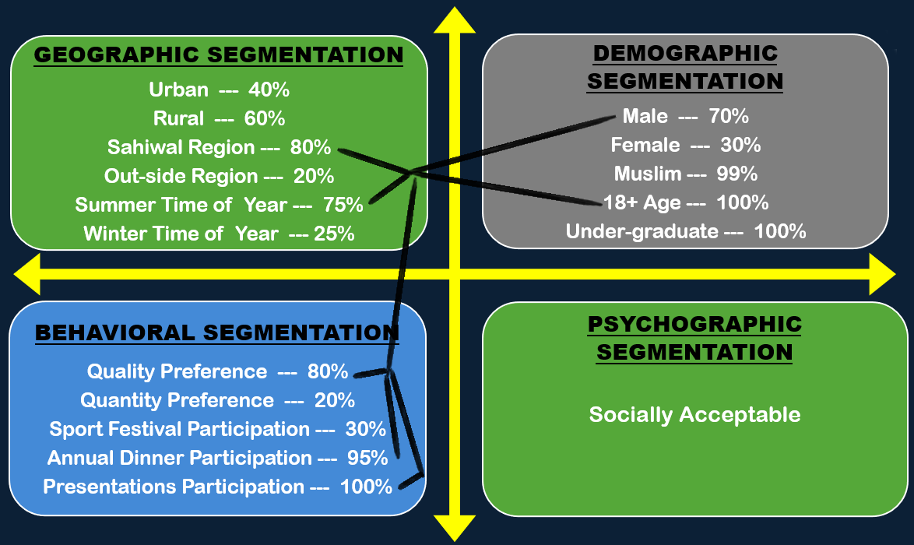

Slide 24
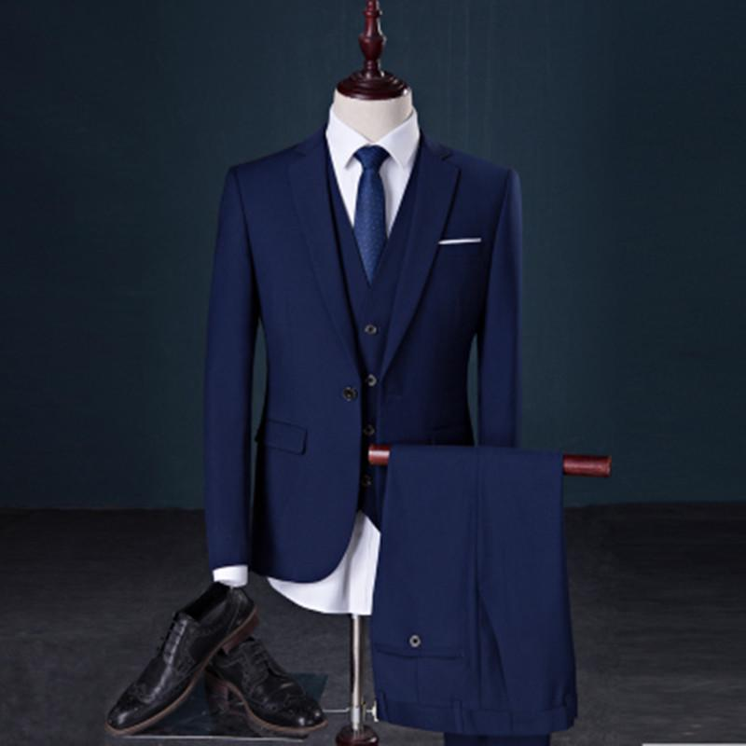
UNDIFFERENTIATED
MARKET TARGETING
A business might decide to
ignore market segment
differences --- and --- Target
the whole market with one offer.
“A advantage -- cost-effective”

Slide 25
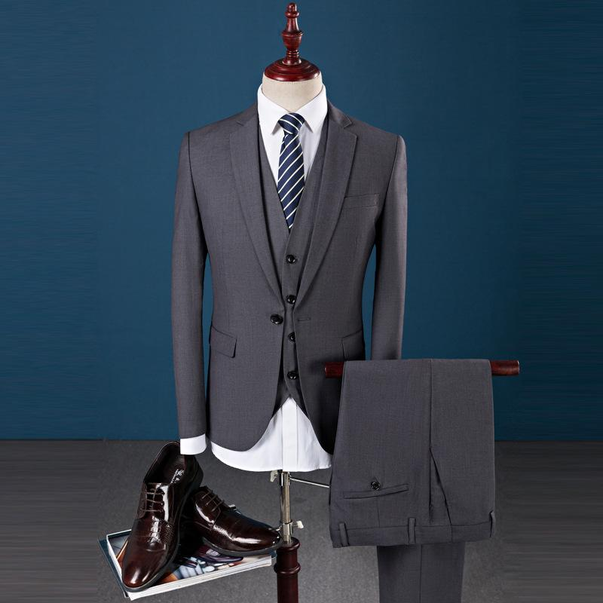
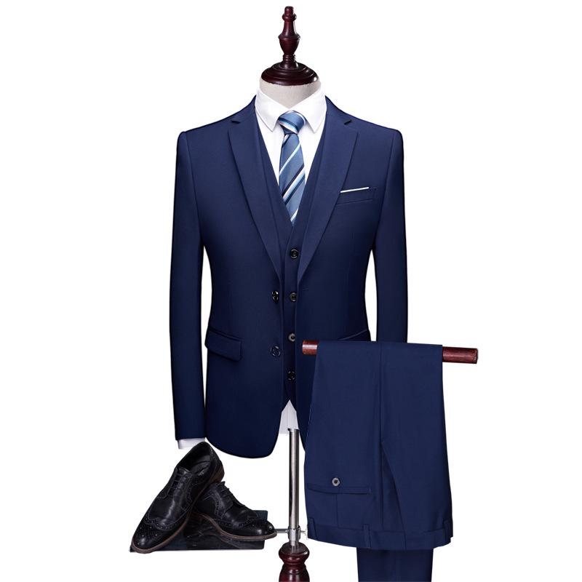
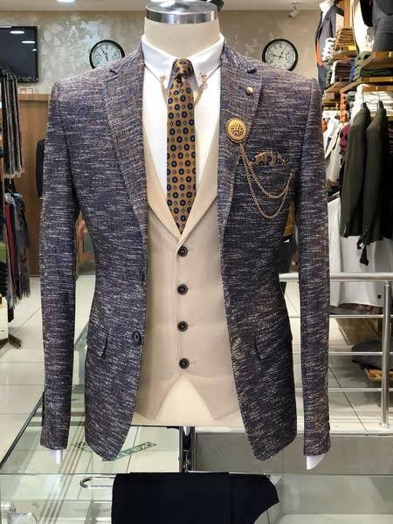
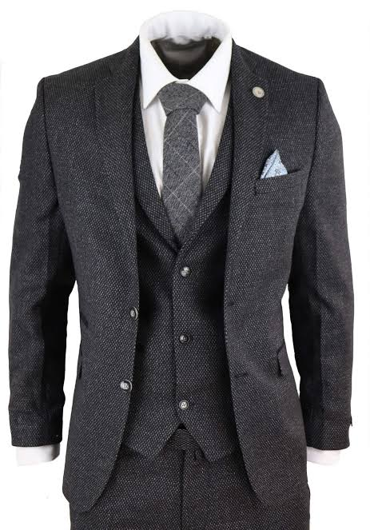
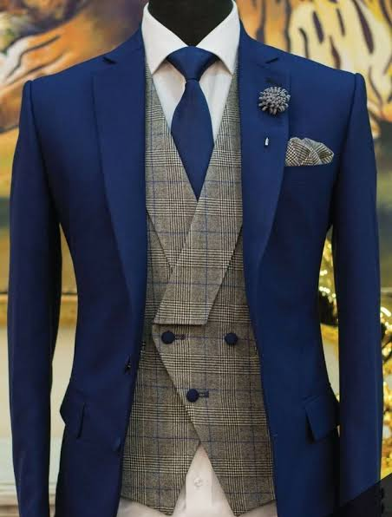
CONCENTRATED MARKET TARGETING
A strategy in which a business target a large share of one or a few segments --- Perform better to achieve their desired business objectives with in a specific market segments.
“High developed and specialized market plan is required”

Slide 26
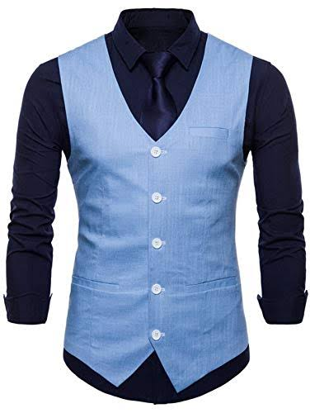
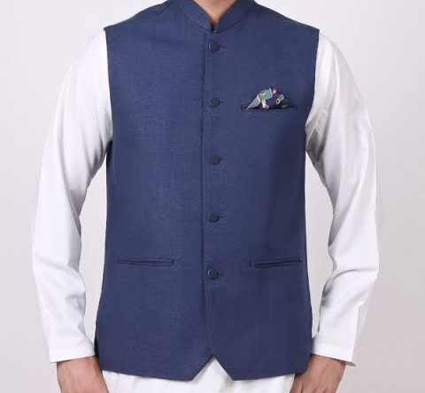
DIFFERENTIATED MARKET TARGETING
The business decides to --- Target two or more clearly defined customer segments --- With a particular product and a unique marketing strategy tailored for every segment.
“A disadvantage --- an expensive activity”

Slide 27
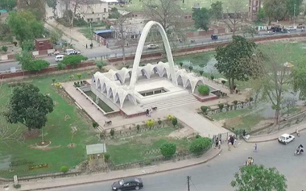
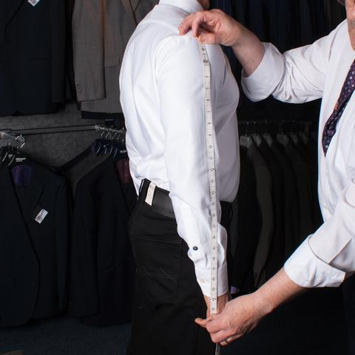
MICROMARKETING MARKET TARGETING
Business focused --- Tailoring products and marketing programs to the needs and wants of specific individuals and local customer segments.

Slide 28

ANY QUESTION
You can contact me at: asadali@uosahiwal.edu.pk
Your query will be answered within one working day.

